Slide 1
Reinforcement Learning
Introduction to Reinforcement Learning.pptx

Slide 2
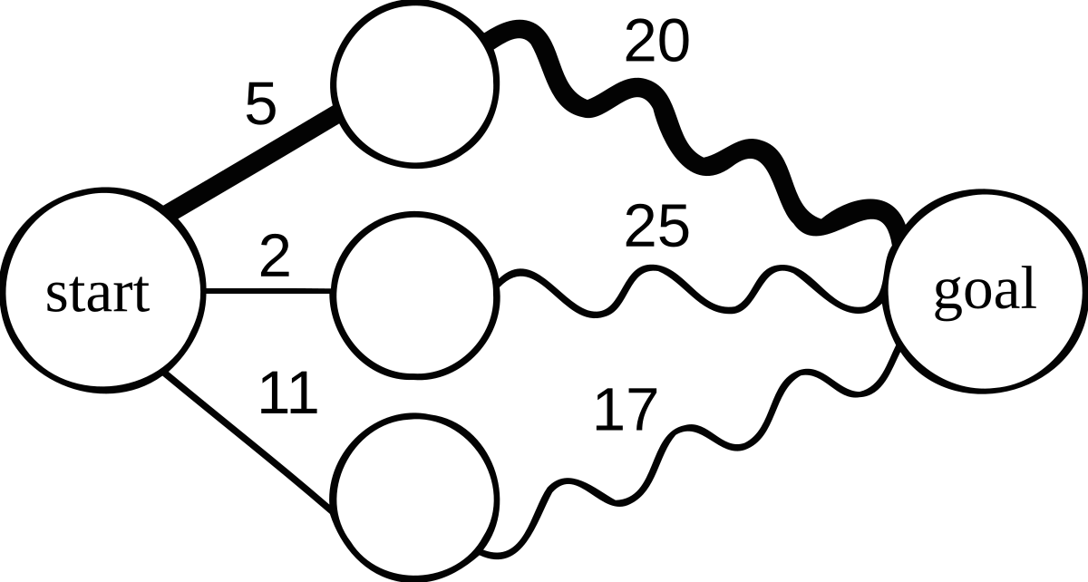
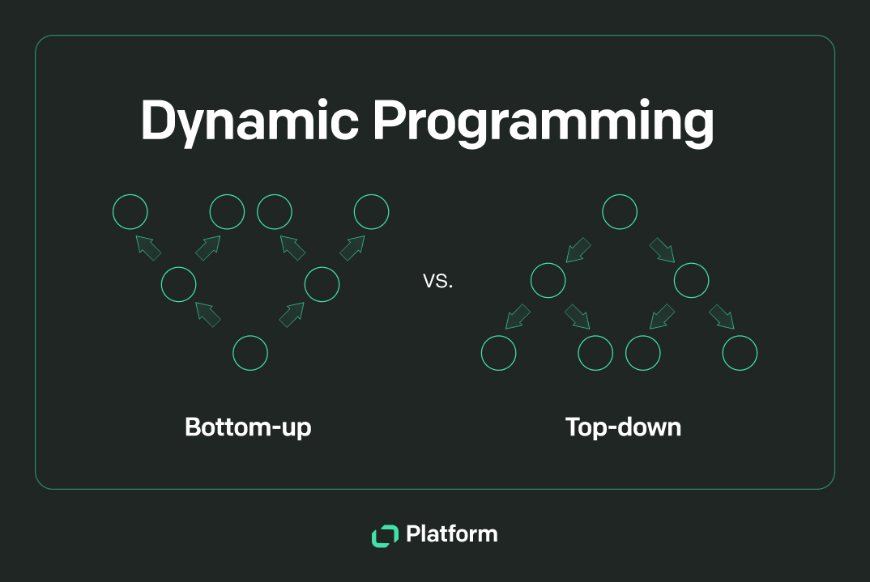
Slide 2
MDPs: A Mathematical Framework for Sequential Decision-Making
Models decision-making under uncertainty
Defined by states, actions, transition probabilities, rewards, and a discount factor
Core to Reinforcement Learning

Slide 3
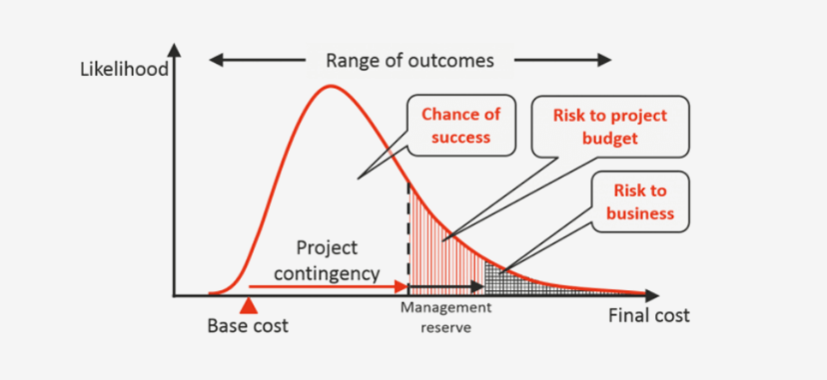
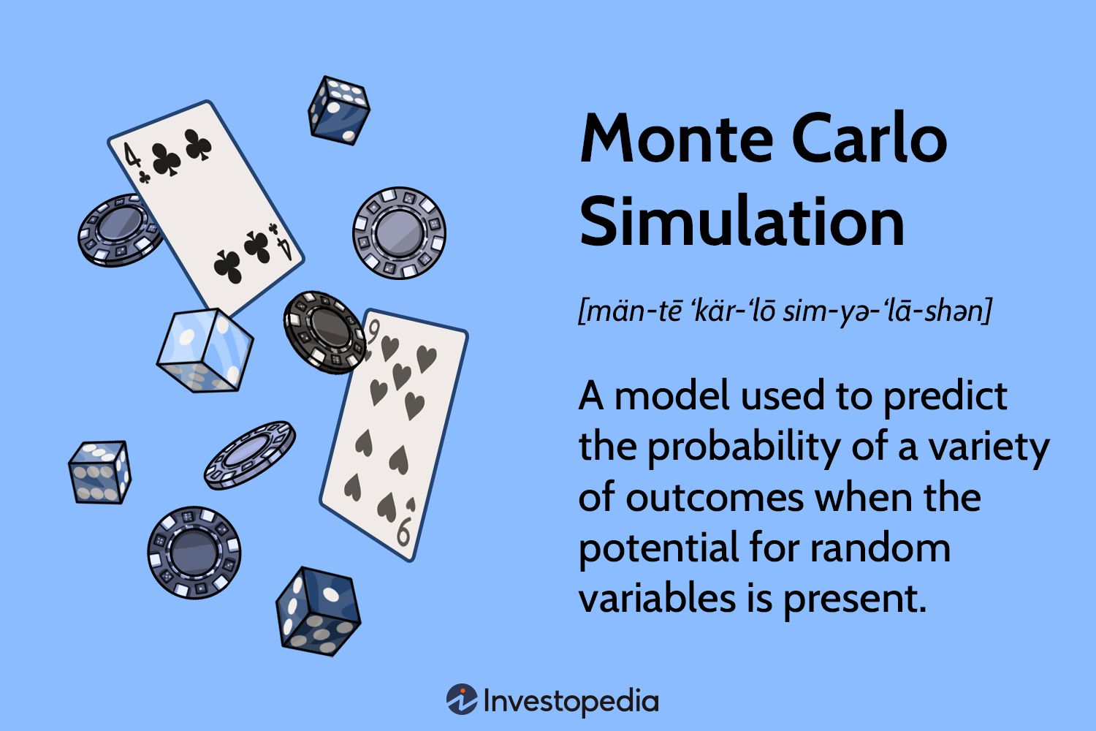
Slide 3
Key Components of an MDP
States (S): Possible states the agent can be in.
Actions (A): Actions the agent can take.
Transition Probabilities (P): P(s'|s, a) – Probability of transitioning to s' from s after taking action a.
Reward Function (R): R(s, a, s') – Immediate reward after taking action a in state s and transitioning to s'.
Discount Factor (γ): 0 ≤ γ ≤ 1. Balances immediate vs. future rewards. Discounted cumulative reward: Σ γt * rt

Slide 4
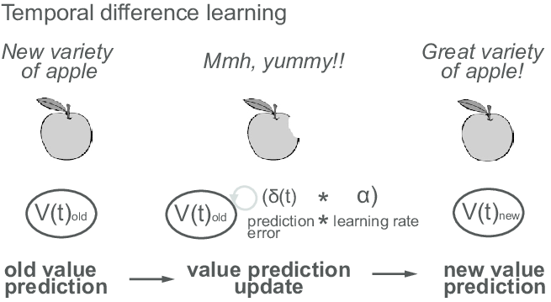
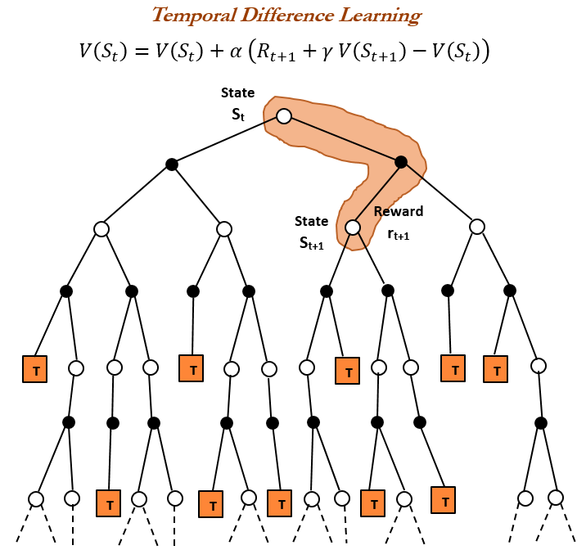
Slide 4
Bellman Equations: The Core of MDP Solution
Value Iteration: V(s) = maxa Σs' P(s'|s, a) * [R(s, a, s') + γV(s')]
Policy Iteration: Vπ(s) = Σs' P(s'|s, π(s)) * [R(s, π(s), s') + γVπ(s')]

Slide 5
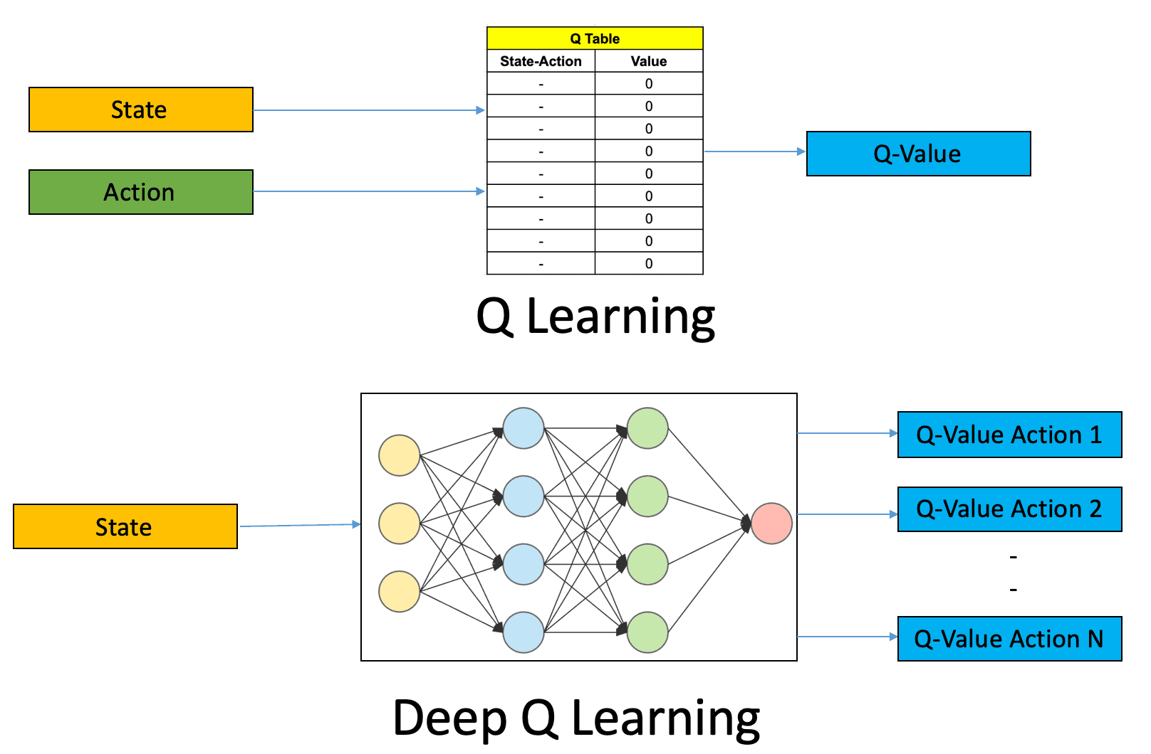
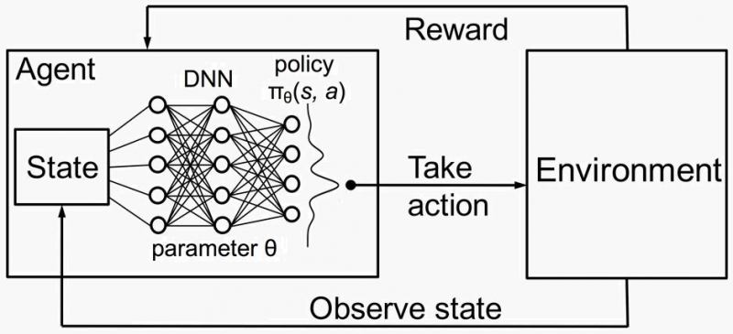
Slide 5
Solving MDPs: Algorithms and Approaches
Value Iteration: Iteratively improves value function estimates until convergence.
Policy Iteration: Iteratively improves policy through policy evaluation and policy improvement steps. Alternates between these steps until convergence.

Slide 6
Slide 7
Dynamic Programming: Solving Sequential Decisions Efficiently
Leverages the principle of optimality: Optimal policy's sub-policies are also optimal.
Breaks down complex problems into smaller, overlapping subproblems.
Solves each subproblem once and stores solutions, avoiding redundant computation.

Slide 7
Slide 8
Bellman Equation in Dynamic Programming
Value Iteration: V(s) = maxa[R(s,a) + γ Σs' P(s'|s,a)V(s')]
Policy Iteration: Vπ(s) = R(s,π(s)) + γ Σs' P(s'|s,π(s))Vπ(s')

Slide 8
Slide 9
Value Iteration Algorithm
Iteratively updates value function V(s) using the Bellman equation until convergence.
Starts with an initial estimate (often V(s) = 0 for all s).
Vk+1(s) = maxa[R(s,a) + γ Σs' P(s'|s,a)Vk(s')]

Slide 9
Slide 10
Policy Iteration Algorithm
Policy Evaluation: Calculate the value function Vπ(s) for a given policy π.
Policy Improvement: Update the policy π'(s) greedily based on Vπ(s): π'(s) = argmaxa[R(s,a) + γ Σs' P(s'|s,a)Vπ(s')]
Repeat until policy converges.

Slide 10
Slide 11
Grid World Example: Applying Dynamic Programming
Simple grid world with a goal and obstacles.
Dynamic programming finds the optimal policy by iteratively calculating state values and determining optimal actions.

Slide 11
Slide 13
Monte Carlo Methods: Learning from Complete Episodes
Model-free: No knowledge of environment dynamics needed.
Learns from complete episodes of experience.
Estimates value functions by averaging returns from multiple episodes.

Slide 12
Slide 14
First-Visit vs. Every-Visit Monte Carlo
First-Visit: Updates value function only for the first visit to a state in an episode.
Every-Visit: Updates value function for every visit to a state in an episode.

Slide 13
Slide 15
Monte Carlo Control: Finding the Optimal Policy
Uses policy iteration: Alternates between policy evaluation and policy improvement.
Requires exploration methods (e.g., ε-greedy) to ensure sufficient exploration of the state-action space.

Slide 14
Slide 16
Grid World Example: Estimating State Values with Monte Carlo
Simulate multiple episodes, recording cumulative rewards.
Estimate state value as the average cumulative reward obtained when starting from that state.

Slide 15
Slide 18
Temporal Difference (TD) Learning: Combining Monte Carlo and DP
Model-free: Learns from experience without explicit environment modeling.
Bootstrapping: Updates estimates based on other estimates.
Incremental updates: Updates estimates after each step, not just at episode end.

Slide 16
Slide 19
TD(0) Algorithm: Updating Value Functions Incrementally
V(St) ← V(St) + α[Rt+1 + γV(St+1) - V(St)]

Slide 17
Slide 20
SARSA and Q-learning: On-Policy vs. Off-Policy Control
SARSA (on-policy): Q(St, At) ← Q(St, At) + α[Rt+1 + γQ(St+1, At+1) - Q(St, At)]
Q-learning (off-policy): Q(St, At) ← Q(St, At) + α[Rt+1 + γ maxa Q(St+1, a) - Q(St, At)]

Slide 18
Slide 22
Deep Reinforcement Learning: Combining RL with Deep Neural Networks
Addresses high-dimensional state and action spaces.
Automatically learns relevant features from raw data.
Enables solving complex problems where traditional methods struggle.

Slide 19
Slide 23
Core Components of a DRL System
Agent: Learner and decision-maker.
Environment: Provides feedback (rewards, observations).
Deep Neural Network: Approximates value function or policy function.

Slide 20
Slide 24
Deep Q-Networks (DQN): Approximating the Q-function
Uses a deep neural network to approximate the Q-function.
Experience replay: Stores and randomly samples past experiences to break correlations and improve stability.
Q-function update based on the Bellman equation.

Slide 21
Slide 25
Actor-Critic Methods: Separating Policy and Value Estimation
Actor: Learns a policy (probability distribution over actions).
Critic: Evaluates the policy by estimating the value function.
Critic provides feedback to the actor to improve the policy.

Slide 22
Slide 26
Challenges and Considerations in DRL
High computational cost
Sample inefficiency
Hyperparameter tuning
Reward shaping

Slide 23
Slide 27
Applications of Deep Reinforcement Learning
Game playing
Robotics
Resource management
Personalized recommendations

Slide 24
Slide 29
Robotics: Learning through Trial and Error
RL enables robots to learn complex tasks.
Examples: Object grasping, navigation, locomotion, manipulation.
Algorithms: Q-learning, policy gradients

Slide 25
Slide 30
Game Playing: Achieving Superhuman Performance
RL has achieved superhuman performance in games like Go and chess.
AlphaGo: Combined deep neural networks and Monte Carlo tree search.
Algorithms: Policy gradients, Monte Carlo tree search

Slide 26
Slide 31
Resource Management: Optimizing Resource Allocation
RL optimizes resource allocation in cloud computing, energy grids, etc.
Goal: Minimize costs while maintaining performance.
Models: Markov Decision Processes (MDPs)

Slide 27
Slide 32
Finance: Algorithmic Trading and Risk Management
RL used in algorithmic trading, portfolio optimization, and risk management.
Learns to identify profitable trading opportunities and manage risk.
Algorithms: Deep reinforcement learning

Slide 28
Slide 33
Personalized Recommendations: Improving User Engagement
RL personalizes recommendations in e-commerce, entertainment, etc.
Goal: Maximize user engagement and satisfaction.
Algorithms: Contextual bandits

